Slide 1

Unit 03.04.03 CS 5220: COMPUTER COMMUNICATIONS
Flow Level: Leaky Bucket Policing
XIAOBO ZHOU, Ph.D.
Professor, Department of Computer Science

Slide 2
Why Congestion?
Congestion
3
6
1
4
8
2
5
7
Approaches to Congestion Control:
Preventive Approaches (open –loop)
Reactive Approaches (closed-loop)

Slide 3
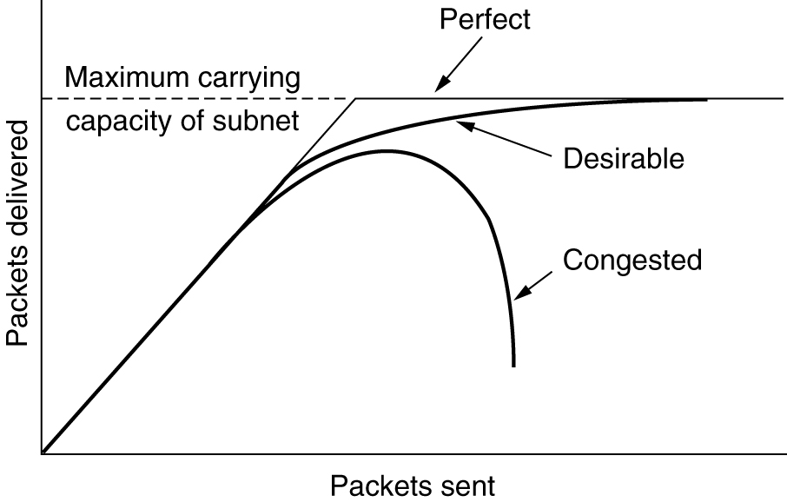
Ideal Effect of Congestion Control
Approaches to Congestion Control:
Preventive Approaches (open –loop)
Reactive Approaches (closed-loop)

Slide 4
Open-Loop Control
Network performance is guaranteed to all traffic flows that have been admitted into the network
Initially for connection-oriented networks
Key Mechanisms
Admission Control
Policing
Traffic Shaping

Slide 5
Admission Control
Flows negotiate contract with network
Specify requirements:
Peak, Avg., Min Bit rate
Maximum burst size
Delay, Loss requirement
Network computes resources needed
“Effective” bandwidth
If flow accepted, network allocates resources to ensure QoS delivered as long as source conforms to contract
Peak rate
Bits/second
Average rate
Time
Typical bit rate demanded by a variable bit rate information source

Slide 6
Policing
Network monitors traffic flows continuously to ensure they meet their traffic contract
When a packet violates the contract, network can discard or tag the packet giving it lower priority
If congestion occurs, tagged packets are discarded first

Slide 7
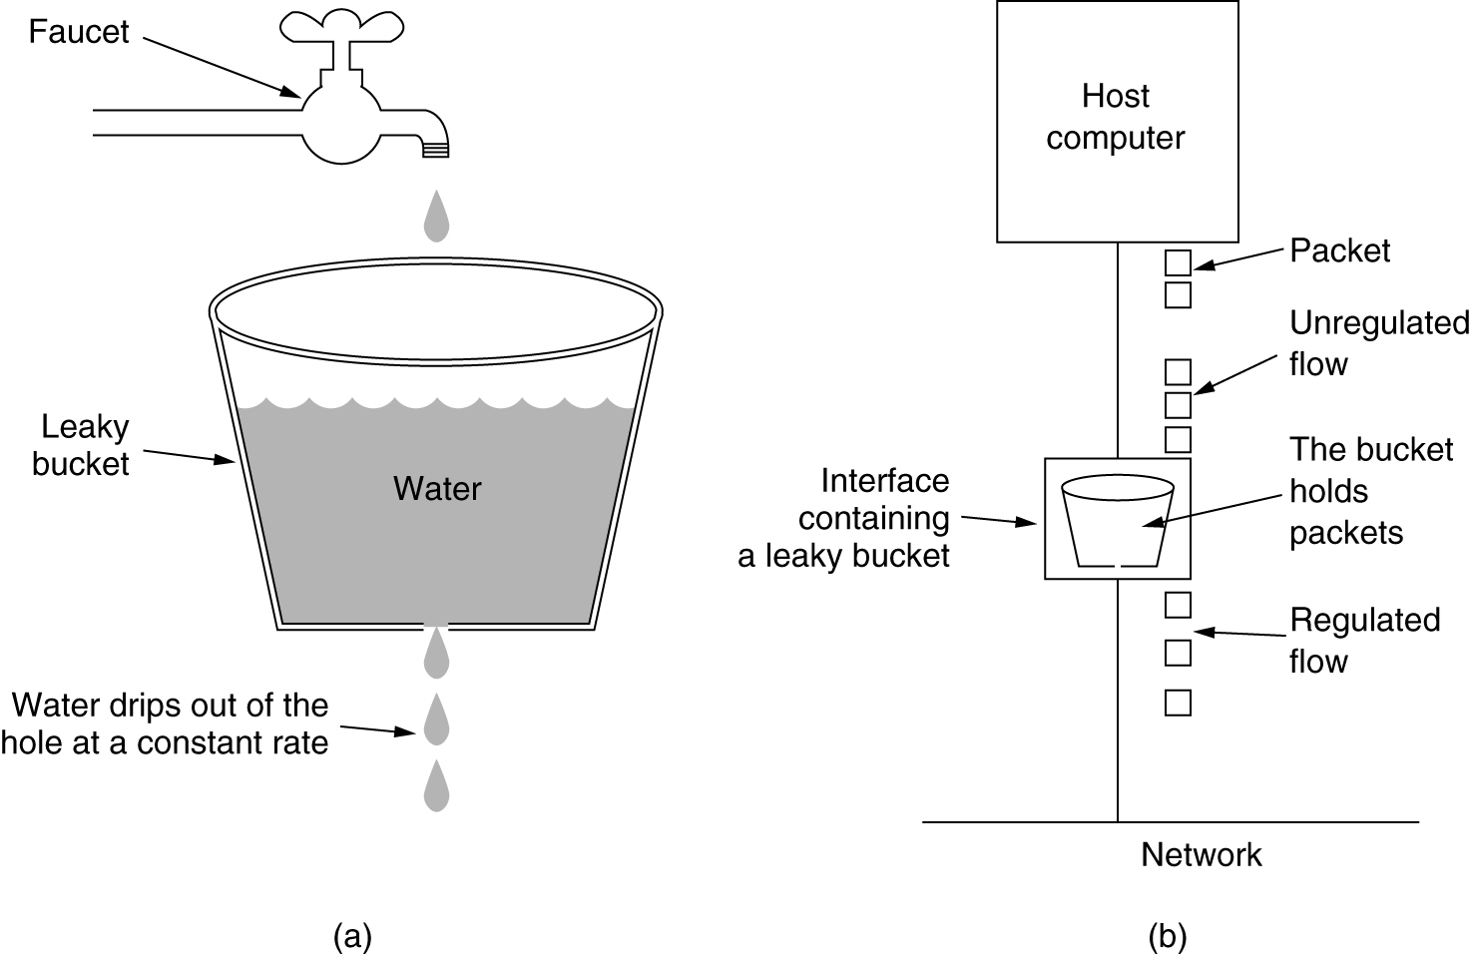
Leaky Bucket Illustration
water poured
irregularly
(a) A leaky bucket with water. (b) a leaky bucket with packets.

Slide 8
Leaky Bucket in ATM Network
ATM Network
All packets are of same fixed length
A counter records the content of the leaky bucket.
When a packet arrives the counter is increased by I if bucket would not exceed the limit, packet is conforming
Value I indicates the nominal inter-arrival time of packets being policed

Slide 9
Summary: Leaky Bucket Example
I = 4 L = 6
Nonconforming
Packet
arrival
t1
t5
t7
Time
L+I
Bucket
content
I
t1
t5
t7
Time
*
*
*
*
*
*
*
*
*
Non-conforming packets not allowed into bucket & hence not included in calculations
maximum burst size (MBS = 3 packets)

